Slide 1
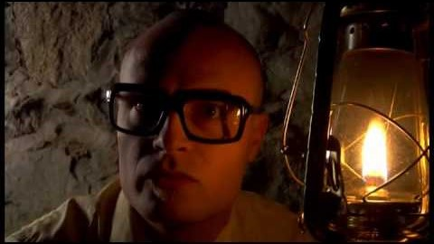
MC Frontalot - It Is Pitch Dark
Notes:
MC Frontalot - It Is Pitch Dark
https://www.youtube.com/watch?v=4nigRT2KmCE

Slide 2
Interactive Fiction and Text Generation
Daphne Ippolito
Chris Callison-Burch
http://interactive-fiction-class.org

Slide 3

Daphne Ippolito
5th year PhD student in NLP
Research Interests
Better coherence for story generation
Understanding the properties and limitations of generated text
Music generation
Decoding strategies for language models

Slide 4

Chris Callison-Burch
Professor in CIS
Research Interests
Machine translation
Natural language understanding
Paraphrases
Fun fact:
I have an army of 200+ R2D2s in my office

Slide 5
Today’s Class
Text Adventure Games
NLP Introduction
Course overview
In-Class Activity

Slide 6
Text Adventure Games

Slide 7
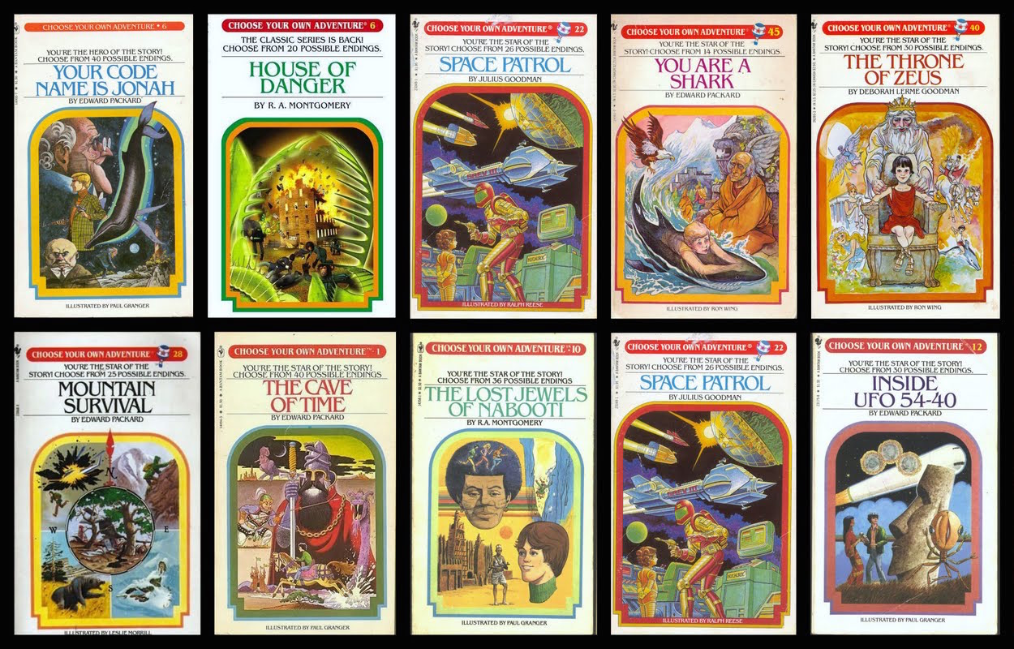
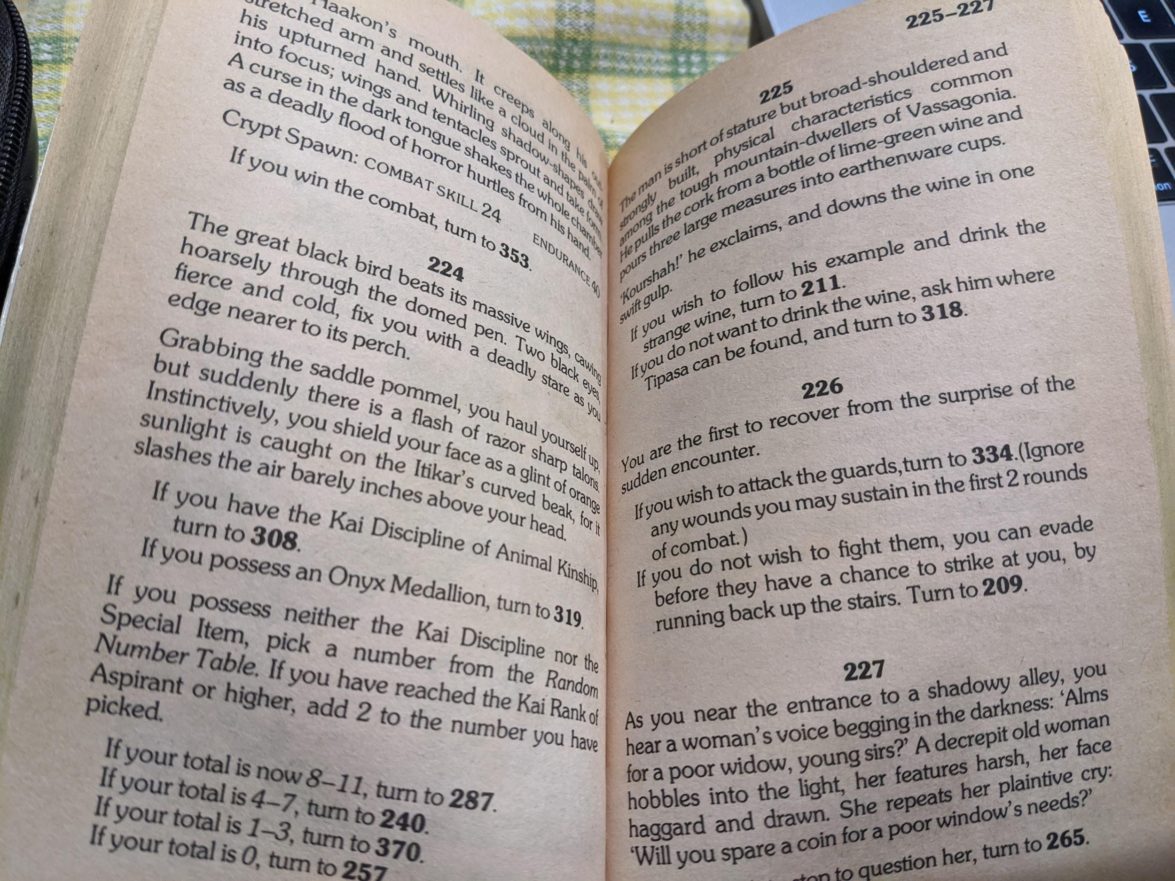
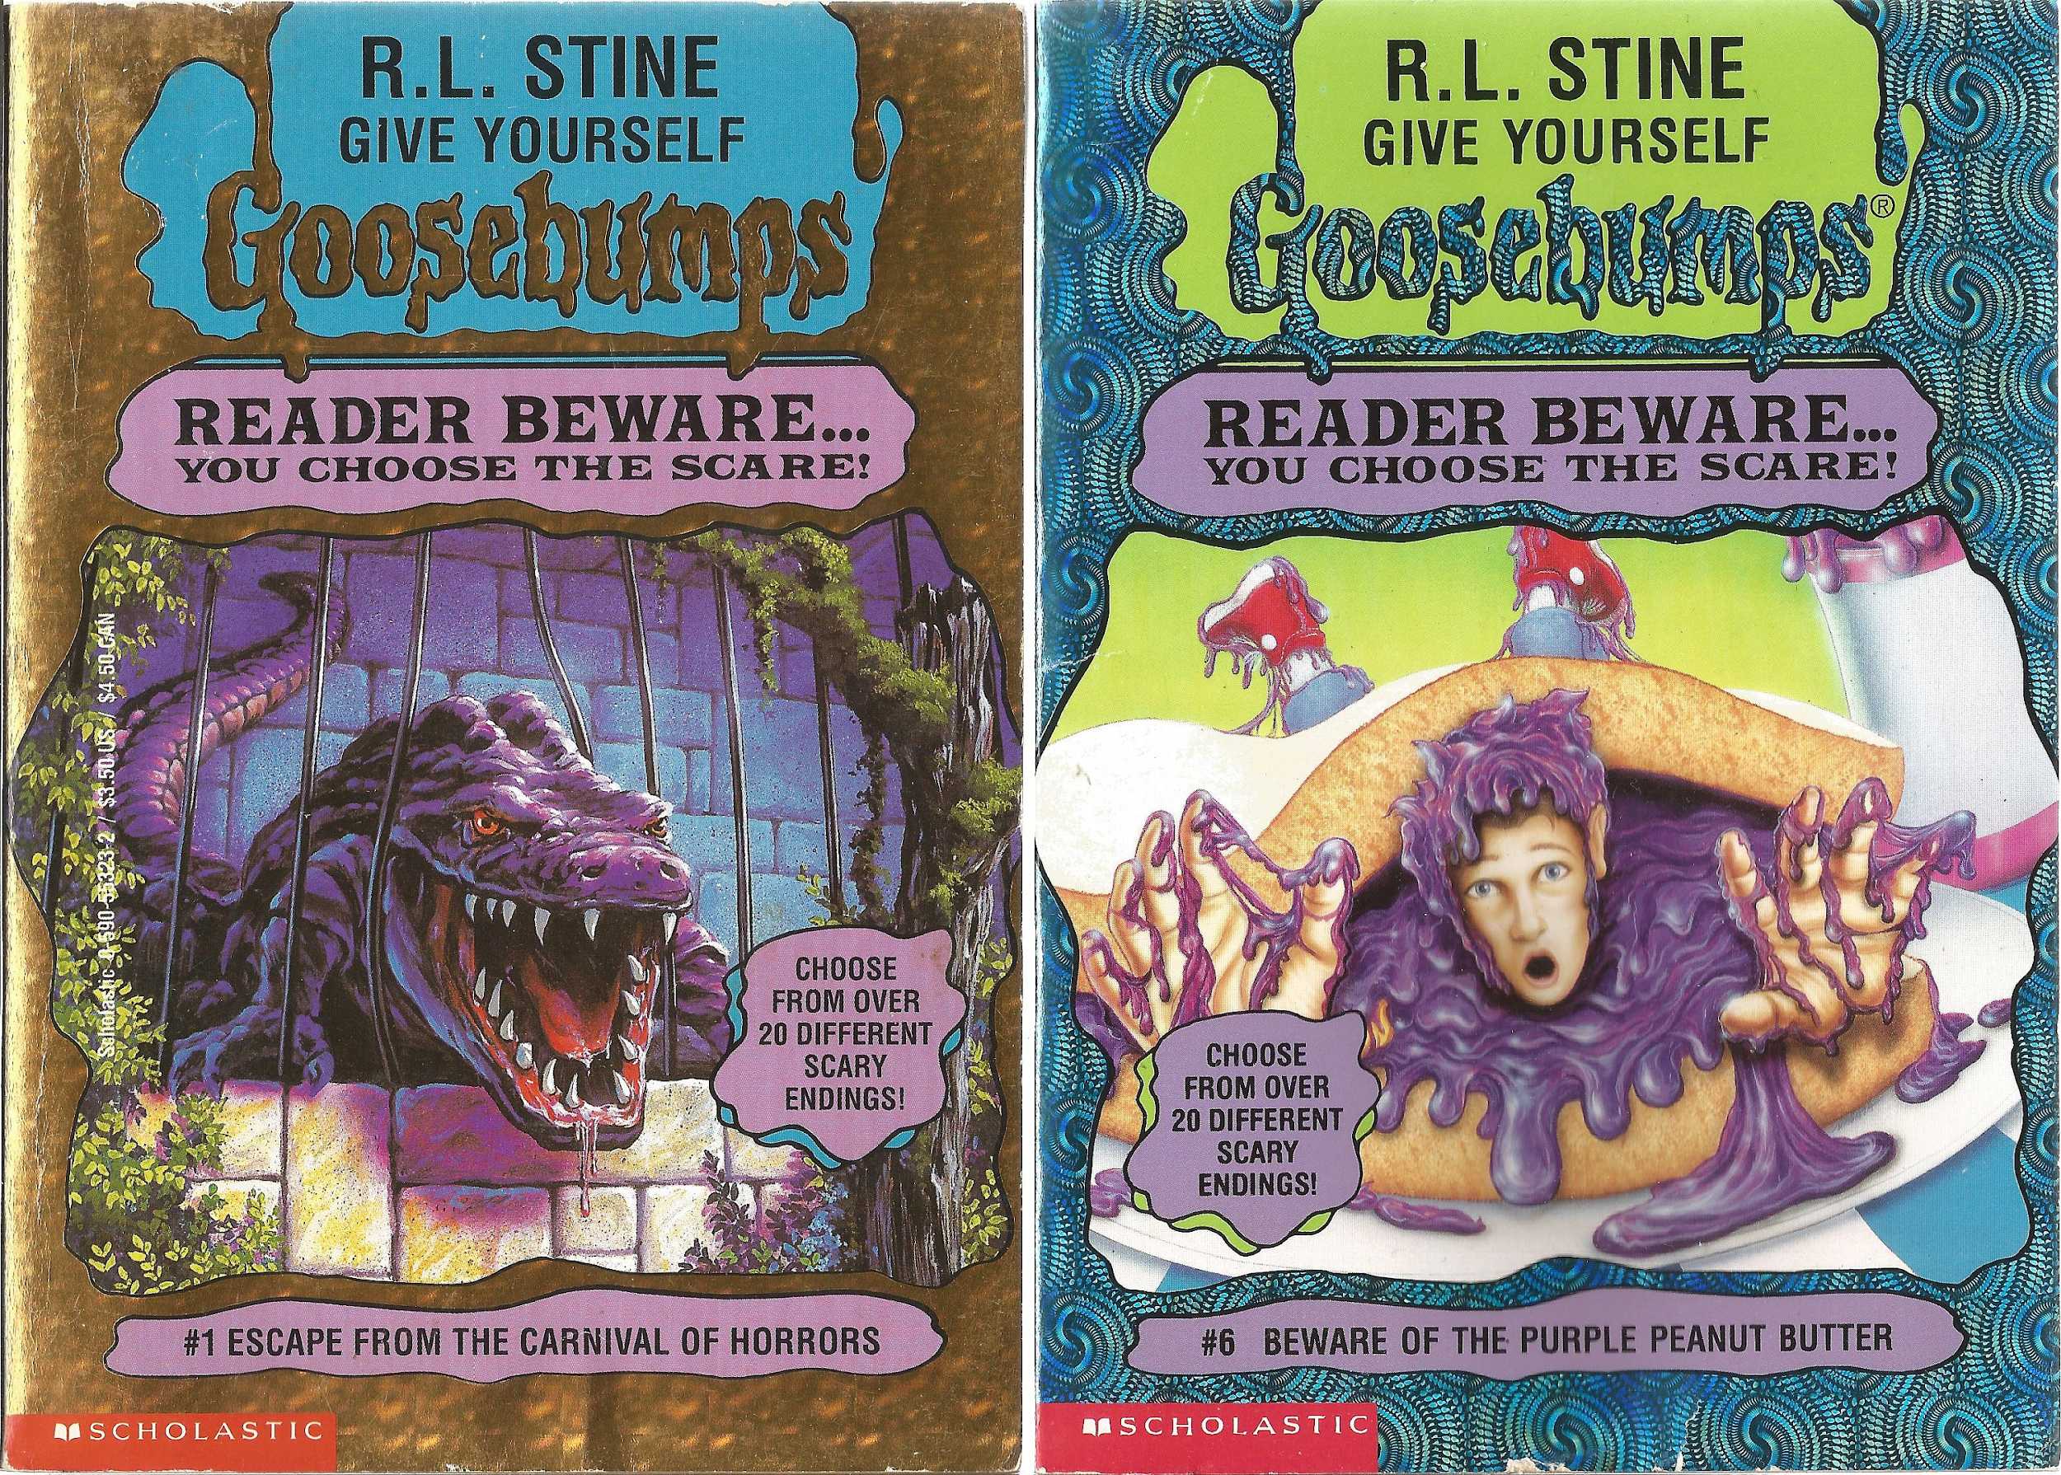
Paper Interactive Fiction
In the 1970s, “Choose your own adventure” books grew in popularity.
Notes:
If you possess the Onyx Medallion, turn to 319.

Slide 8
Paper Interactive Fiction
In the 1970s, “Choose your own adventure” books grew in popularity.
TODO: screenshot
Notes:
If you possess the Onyx Medallion, turn to 319.
If you wish to fight them, page 334, otherwise page 209.

Slide 9
Notes:
From https://www.seanmichaelragan.com/html/[2008-03-07]_Choose_Your_Own_Adventure_book_as_directed_graph.shtml

Slide 10
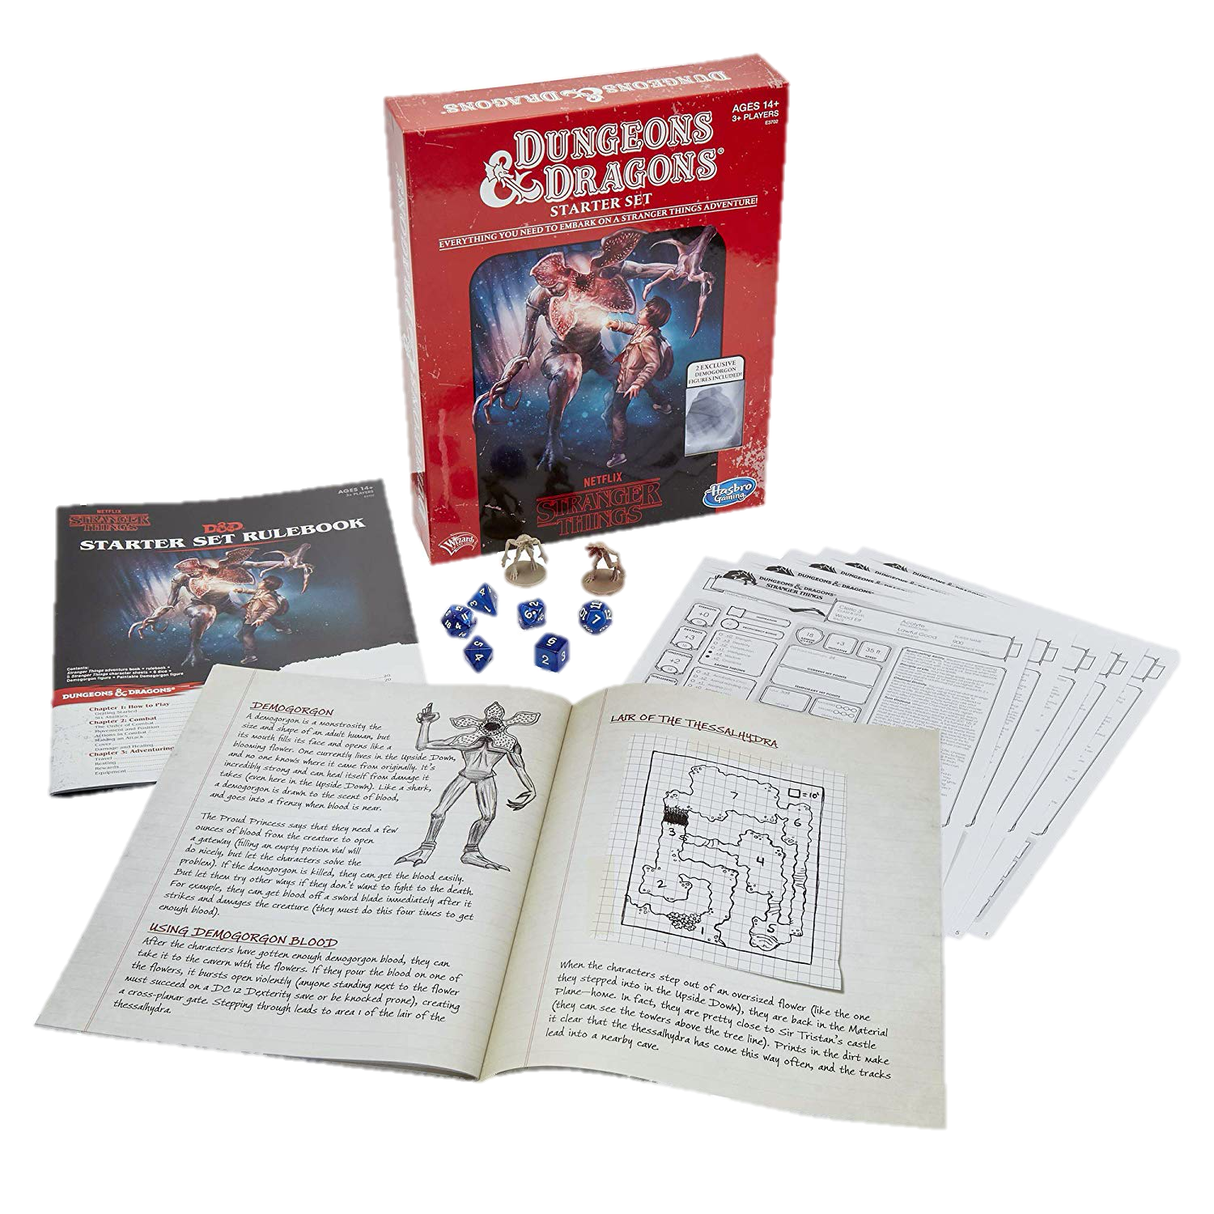
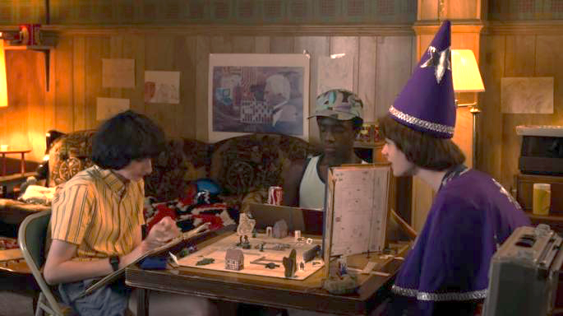
Paper & Pencil Interactive Fiction
Dungeons & Dragons is a fantasy tabletop role playing game first published in 1974.
Notes:
One forebearer of IF is the fantasy role-playing playing game Dungeons and Dragons, a framework for a theatrical interaction, for the exploration of simulated spaces, and for puzzle solving.

Slide 11
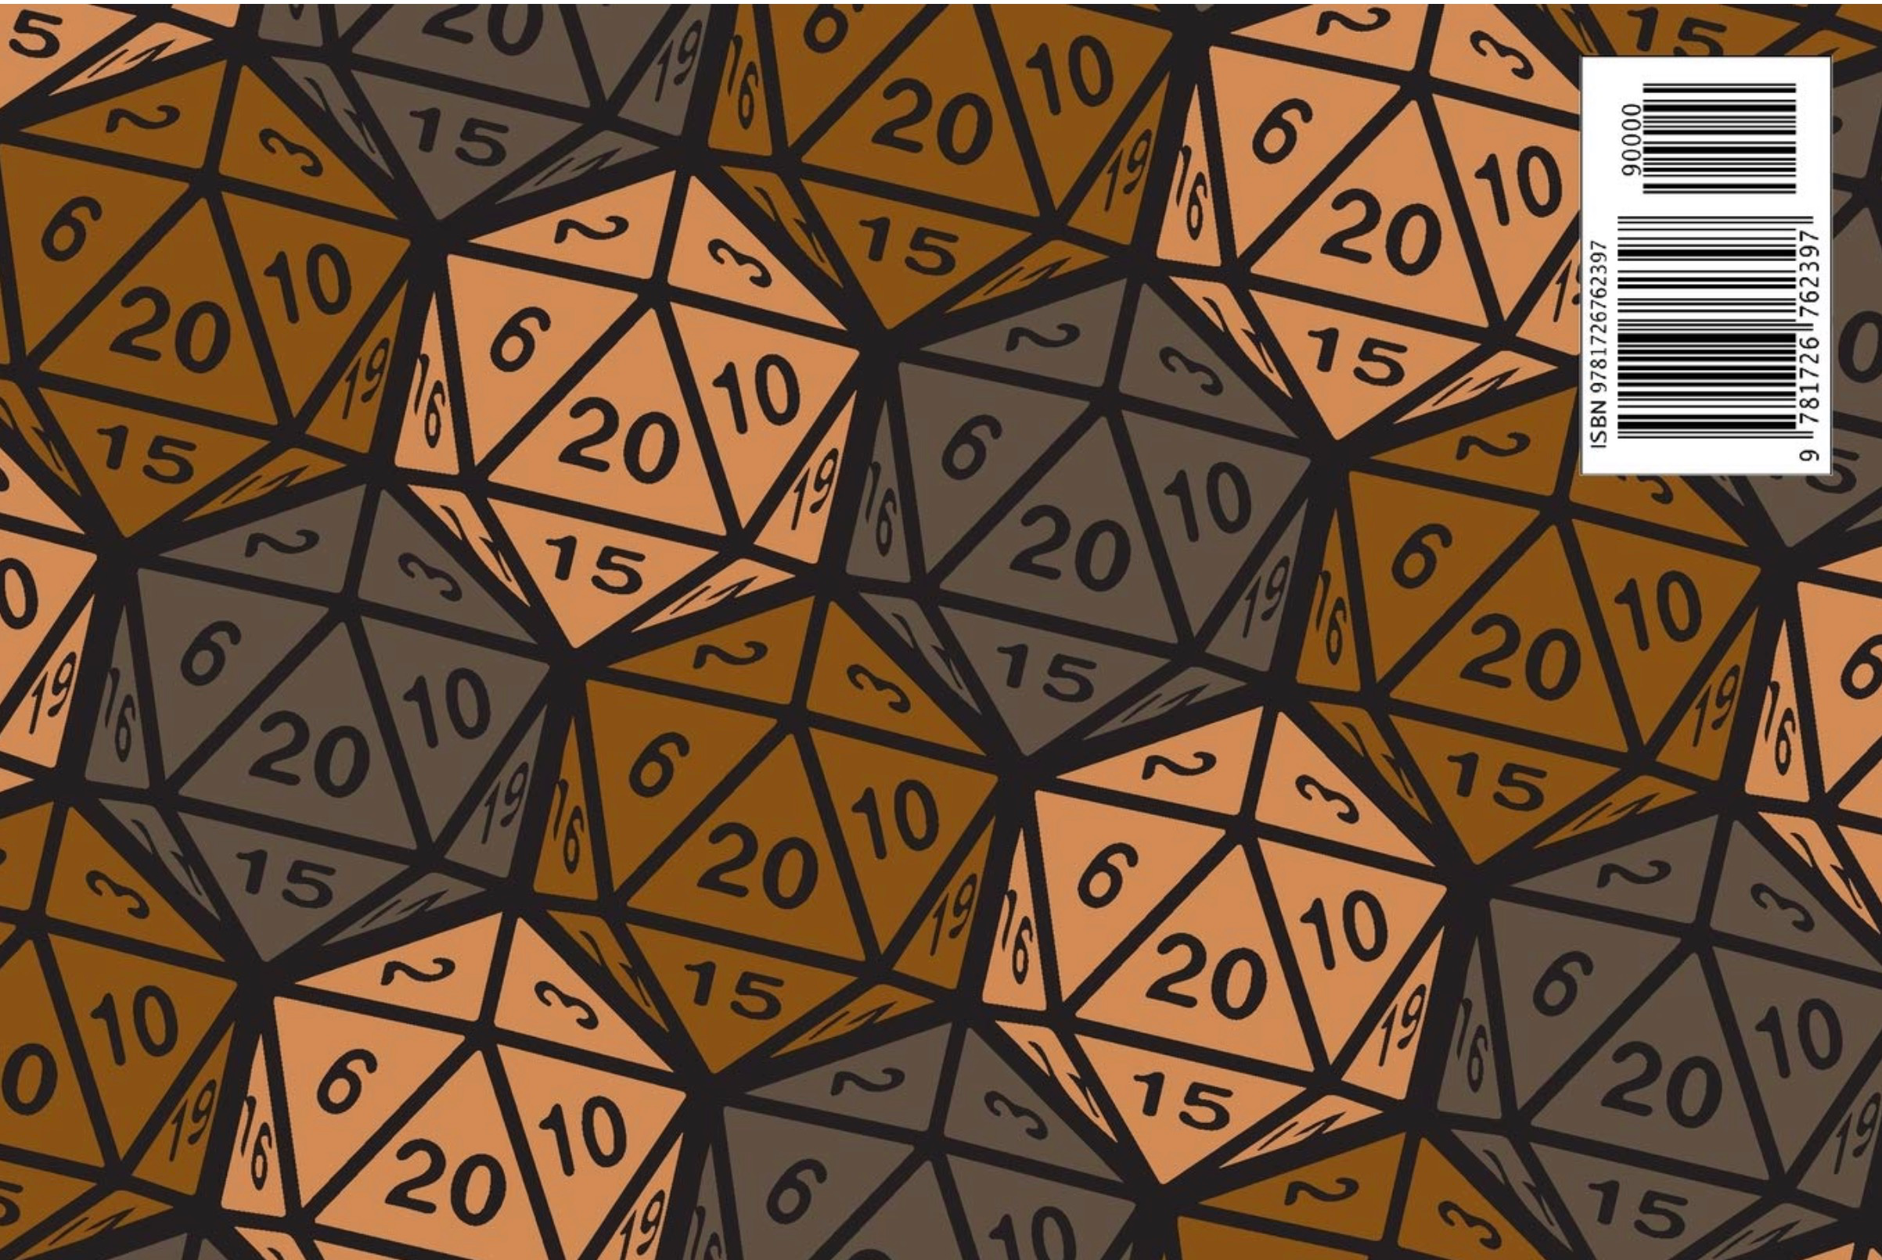
DUNGEONS AND DRAGON
D&D is an open-ended game in which the players assume the roles of characters in a story and can have them attempt any action they want. The game is controlled by a dungeon master, who uses tables, dice, and personal judgment to decide on the effect of a character’s efforts.
The players say what their characters do within the world of the campaign. Dice are rolled to help determine the outcome of combat and other encounters. Over the course of many adventures, the members of a party advance in level and become more powerful-and the dungeon master devises new challenges for them.
Notes:
Dice, are frequently used in a typical game. The twenty-sided die and other dice of unusual shape have become iconic. Dice are used to introduce unpredictability; based on the roll of a die, events may transpire that were not anticipated, foiling even the dungeon master’s plans.

Slide 12
Computer Games Before Graphics
Interactive Fiction/Text Adventure Games were the best-selling computer games of the 1980s. A company called Infocom created the most popular titles.

Slide 14
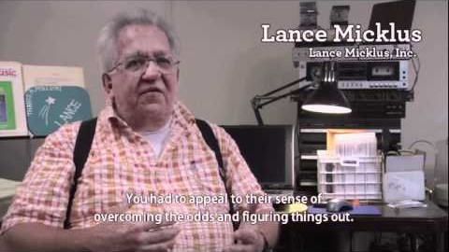
https://www.youtube.com/watch?v=LRhbcDzbGSU&t=3398
Notes:
https://www.youtube.com/watch?v=LRhbcDzbGSU&t=3398
Start at 56:38 - Best computer you can get is your brain / joy of reading + stori
End at 58:21 - Potential end point (“A story can have meaningful consequences … in a way that had never been seen before”)

Slide 15
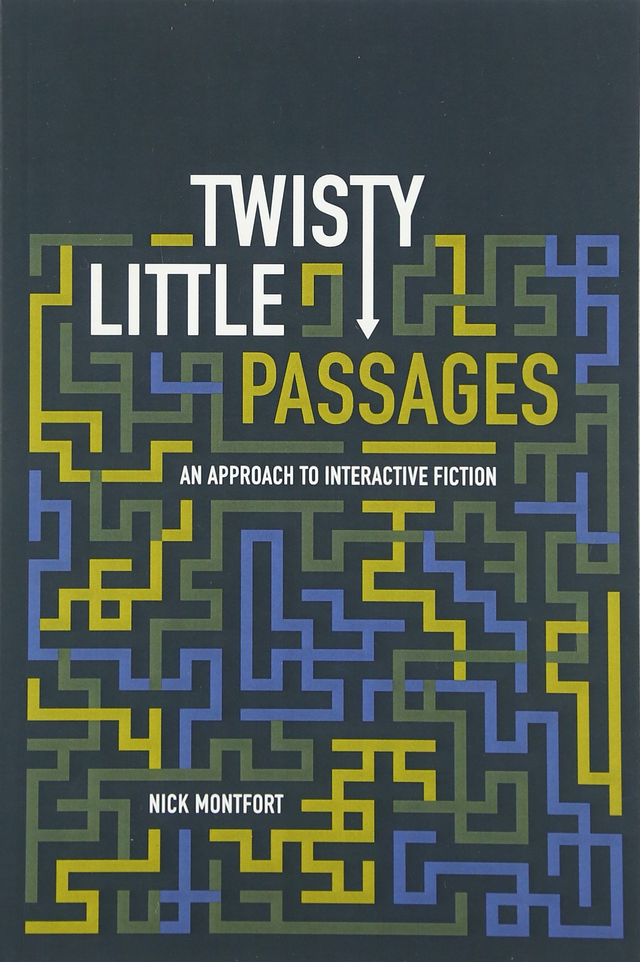
Components of Interactive Fiction Games
The parser, which is the component that analyzes natural language input in an interactive fiction work.
The world model, which is setting of an interactive fiction work.
Notes:
The simulated world is represented computationally in some sort of data structure or collection of objects. It is this simulated world that distinguishes a work of interactive fiction from a conversational character or from an expert system that employs natural language understanding.

Slide 16
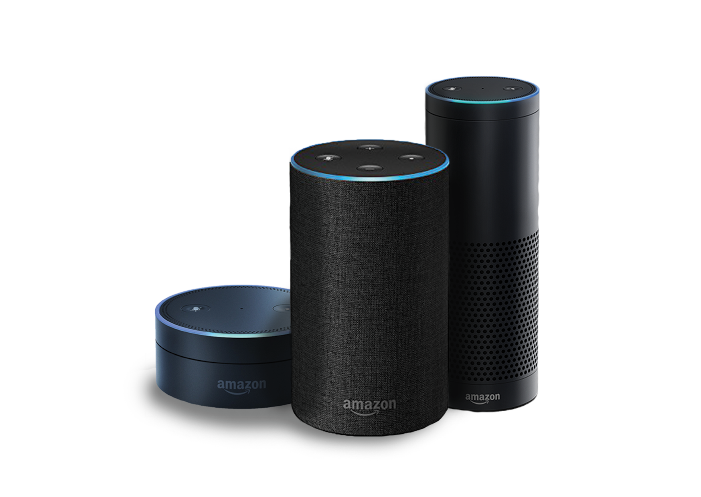

Natural Language Understanding
Will it rain tomorrow? Set an alarm for 6:30a.m. Play music from They Might Be Giants. How many pints are in a gallon? Add blueberries to my shopping list. When did California become a state? When is the Winter solstace? What is the weather like in Hawaii this weekend? Turn off the lights. Open the pod bay doors.

Slide 17
Turing Test
The idea of computer conversation was developed along with the general-purpose purpose digital compute. Turing presented it in his 1950 paper “Computing Machinery and Intelligence”. Which introduced the Turing Test. The question “Can machines think?” could then be replaced by one that was easier to answer: “Are there imaginable digital computers which would do well in the imitation game?”
Turing highlighted lighted the importance of conversational ability to our perception of intelligence, at a time when computers almost exclusively processed numbers rather than language.
Notes:
The idea of computer conversation was developed along with the general-purpose purpose digital computer; Turing (1950) presented it quite clearly in his influential paper “Computing Machinery and Intelligence,” in which he established the Turing Test. He gave the example of a parlor game in which a person of one gender tries to imitate a person of the other, and then suggested a similar game in which a computer would imitate a human in conversation. The question “Can machines think?” could then be replaced by one that was easier to answer: “Are there
imaginable digital computers which would do well in the imitation game?” (Turing 1950, 54-55). In formulating this test, Turing highlighted lighted the importance of conversational ability to our perception of intelligence, at a time when computers almost exclusively processed numbers rather than language.
The “imitation game” is a party game, where a man and a woman go into separate rooms and guests try to tell them apart by writing a series of questions and reading the typewritten answers sent back. In this game both the man and the woman aim to convince the guests that they are the other.
"Computing Machinery and Intelligence" (Mind, October 1950), Turing addressed the problem of artificial intelligence, and proposed an experiment that became known as the Turing test, an attempt to define a standard for a machine to be called "intelligent". The idea was that a computer could be said to "think" if a human interrogator could not tell it apart, through conversation, from a human being.

Slide 18
Turing Test
A human evaluator would judge text-based conversations between a human and a machine designed to generate human-like responses. If the evaluator cannot reliably tell the machine from the human, the machine is said to have passed the test. The test results do not depend on the ability to give correct answers to questions, only how closely one's answers resemble those a human would give.
Notes:
The idea of computer conversation was developed along with the general-purpose purpose digital computer; Turing (1950) presented it quite clearly in his influential paper “Computing Machinery and Intelligence,” in which he established the Turing Test. He gave the example of a parlor game in which a person of one gender tries to imitate a person of the other, and then suggested a similar game in which a computer would imitate a human in conversation. The question “Can machines think?” could then be replaced by one that was easier to answer: “Are there
imaginable digital computers which would do well in the imitation game?” (Turing 1950, 54-55). In formulating this test, Turing highlighted lighted the importance of conversational ability to our perception of intelligence, at a time when computers almost exclusively processed numbers rather than language.
The “imitation game” is a party game, where a man and a woman go into separate rooms and guests try to tell them apart by writing a series of questions and reading the typewritten answers sent back. In this game both the man and the woman aim to convince the guests that they are the other.
"Computing Machinery and Intelligence" (Mind, October 1950), Turing addressed the problem of artificial intelligence, and proposed an experiment that became known as the Turing test, an attempt to define a standard for a machine to be called "intelligent". The idea was that a computer could be said to "think" if a human interrogator could not tell it apart, through conversation, from a human being.

Slide 19
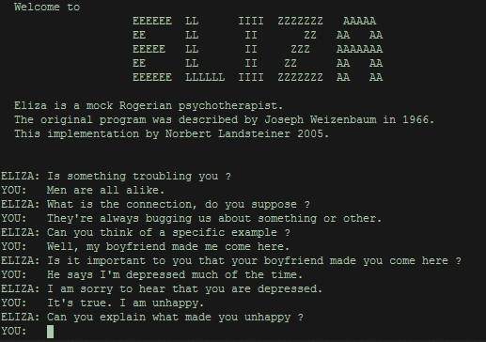
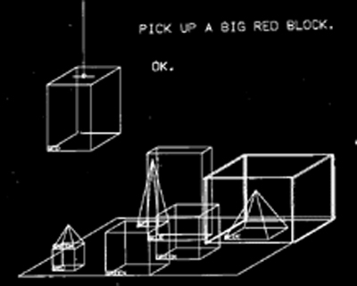
Early Natural Language Understanding
Notes:
The software programs ELIZA (1964–1966) and SHRDLU (1968–1970) were examples of early interactive natural language understanding. Both programs used natural language processing (NLP) to take input from their user and respond in a virtual and conversational manner. ELIZA simulated a psychotherapist that appeared to provide human-like responses to the user’s input, while SHRDLU employed an artificial intelligence that could move virtual objects around an environment and respond to questions asked about the environment’s shape. The development of effective natural language processing is an important part of interactive fiction development.

Slide 20
ELIZA
ELIZA is a language analysis program that can run scripts to have different sorts of conversations; the most famous script was DOCTOR, which was “designed to permit it to play (or parody) the role of a Rogerian psychotherapist engaged in an interview with a patient”.
ELIZA was the first computer conversationalist, the first chatbot. ELIZA searched for keywords in input. If some were found, the program would transform the input according to a rule and print out the transformed sentence. If none were found, it would provide a default (usually noncommittal) output like “What makes you say that?”
Notes:
ELIZA is a language analysis program that can run many different ferent scripts and have different sorts of conversations; the most famous script by far was called DOCTOR, which Weizenbaum (1976) explained was “designed to permit it to play (I should really say parody) the role of a Rogerian psychotherapist engaged in an initial interview with a patient”.
Although ELIZA was later used to do more sophisticated types of natural language understanding (Weizenbaum 1967; Winograd 1972, 38), Weizenbaum (1976) made it clear that it in no way offered a general solution tion to the problem of natural language understanding.
Nevertheless, users were quite affected by it. Weizenbaum wrote that he “was startled to see how quickly and how very deeply people conversing with DOCTOR became emotionally involved with the computer” (6). Janet Murray (1997) described him as being “so disconcerted by his achievement that he wrote a book warning of the dangers of attributing human thought to machines” (71).
Some psychiatrists thought ELIZA/DOCTOR should be used in therapy; apy; people took contradictory positions on big questions in artificial intelligence gence based on ELIZA/DOCTOR; and the program inspired its own branch of computer literature based on conversation with fictional characters ters

Slide 21
SHRDLU
Terry Winograd’s SHRDLU had a dialog with the user via teletype and displayed an image of a tabletop with blocks on it. It could respond to natural language commands in real time. It would move the simulated blocks around if asked to; it could also answer questions about them.
SHRDLU used its knowledge of the simulated world to help it parse input. It represented its knowledge as procedures. SHRDLU had several different components. There was a module for generating replies to the user,, and one for simulating the blocks world.
Notes:
Terry Winograd’s SHRDLU, which he programmed in LISP at the MIT Artificial Intelligence Laboratory during ing 1968-1970
This program (named after the second row of keys on a Linotype machine; see Winograd 1999)) carried on a dialog with the user via teletype, also displaying an image of a tabletop with blocks on it. It could respond to natural language commands in real time,
It would move the simulated blocks around if asked to; it could also answer questions about them.
SHRDLU used its knowledge of the simulated world to help it parse input. It represented its knowledge as procedures.
SHRDLU had eleven different components. There was a module for generating replies to the user, for instance, and one for simulating the blocks world (Winograd 1972). Here is a short excerpt from a much longer SHRDLU sample transcript:
SHRDLU was able to understand almost any input just about anything that a human could understand-as long as it pertained to the blocks world.

Slide 22
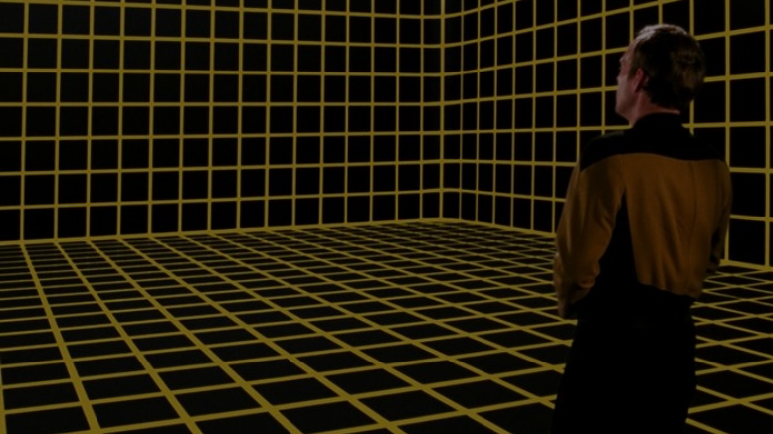
Simulated World
What’s the difference between a conversational agent and a work of interactive fiction? The simulated world.
It represents the physical environment, and things like • Settings or locations • Physical objects in each setting • The player’s character • Non-player characters It also represents and simulates the physical laws of the environment.
Notes:
The world model is typically implemented in the interactive fiction program as some type of graph or tree with associated procedures.

Slide 23
Locations
You are at a complex junction. A low hands and knees passage from the north joins a higher crawl from the east to make a walking passage going west. There is also a large room above. The air is damp here.
A location in Colossal Cave Adventure by Will Crowther (1975)
Notes:
https://en.wikipedia.org/wiki/Colossal_Cave_Adventure

Slide 24
Colossal Cave Adventure
You are standing at the end of a road before a small brick building. Around you is a forest. A small stream flows out of the building and down a gully.
> go south
You are in a valley in the forest beside a stream tumbling along a rocky bed.
Notes:
Adventure has the player's character explore a mysterious cave that is rumored to be filled with treasure and gold. To explore the cave, the player types in one- or two-word commands to move their character through the cave, interact with objects in the cave, pick up items to put into their inventory, and other actions. The program acts as a narrator, describing to the player what each location in the cave has, the results of certain actions, or if it did not understand the player's commands, asking for the player to retype their actions.

Slide 25

Navigation in a Text-based World
Cardinal Directions: Go North/South/East/West/
Northwest/Northeast/Southwest/Southeast
Also: Go Up, Down, In and Out
One letter commands were also supported: N/E/S/W/NE/SE/NW/SW
Look/L: look around to see what is nearby
Not every direction is possible in every location.

Slide 26
As a Data Structure
You can implement an IF game as a directed graph.
Each location in a node in the graph.
Edges are connections to adjacent locations.
Edges are labeled with the direction.
Possible commands at a location are
the labels of the outward edges.
Locations can hold Objects.

Slide 27
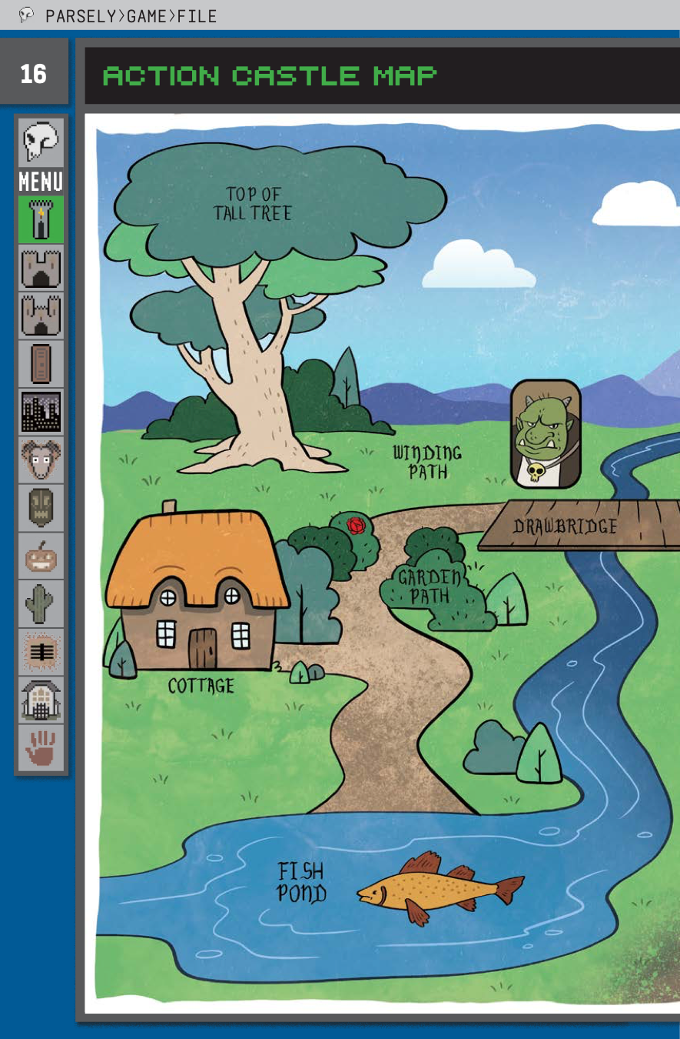
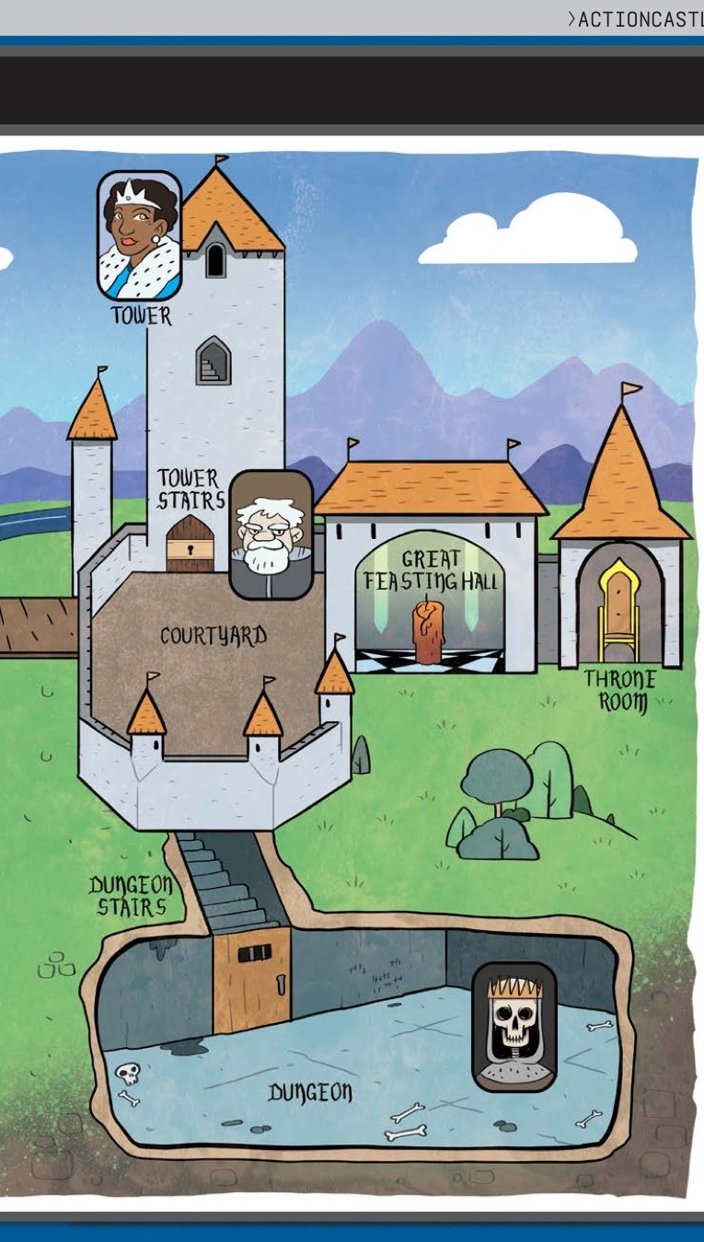
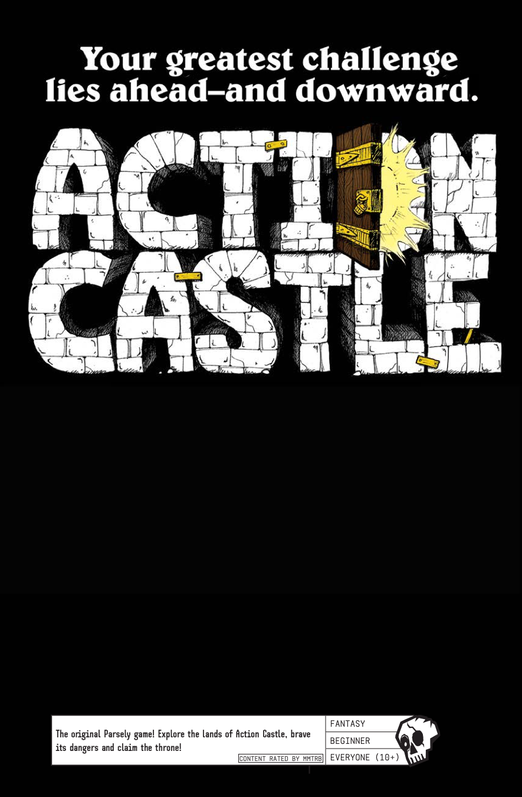
Notes:
This is the Action Castle map from Jared A Sorensen’s Parsley book.

Slide 28
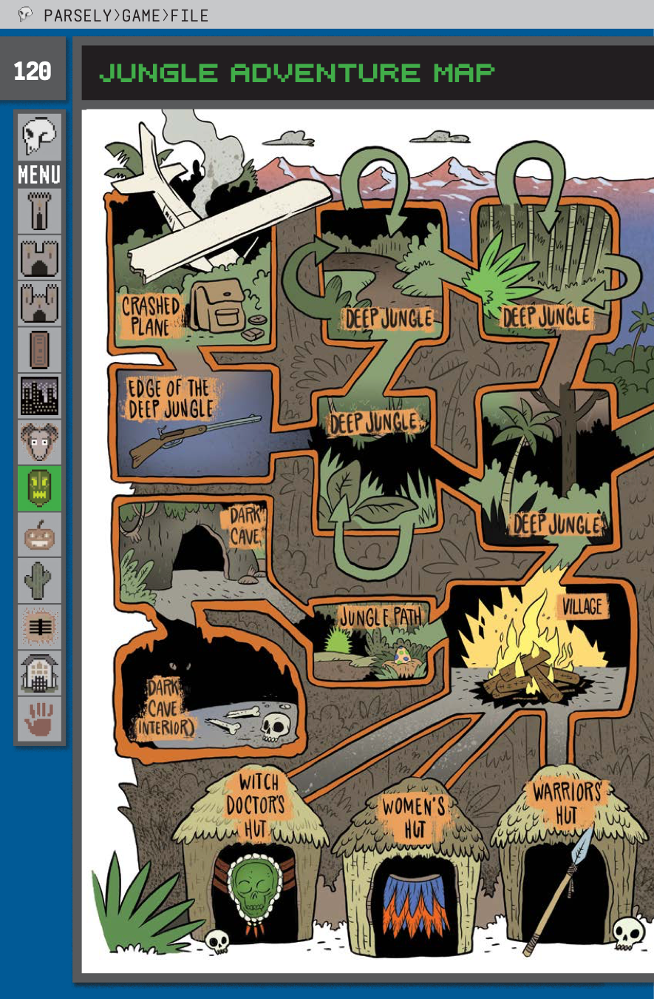
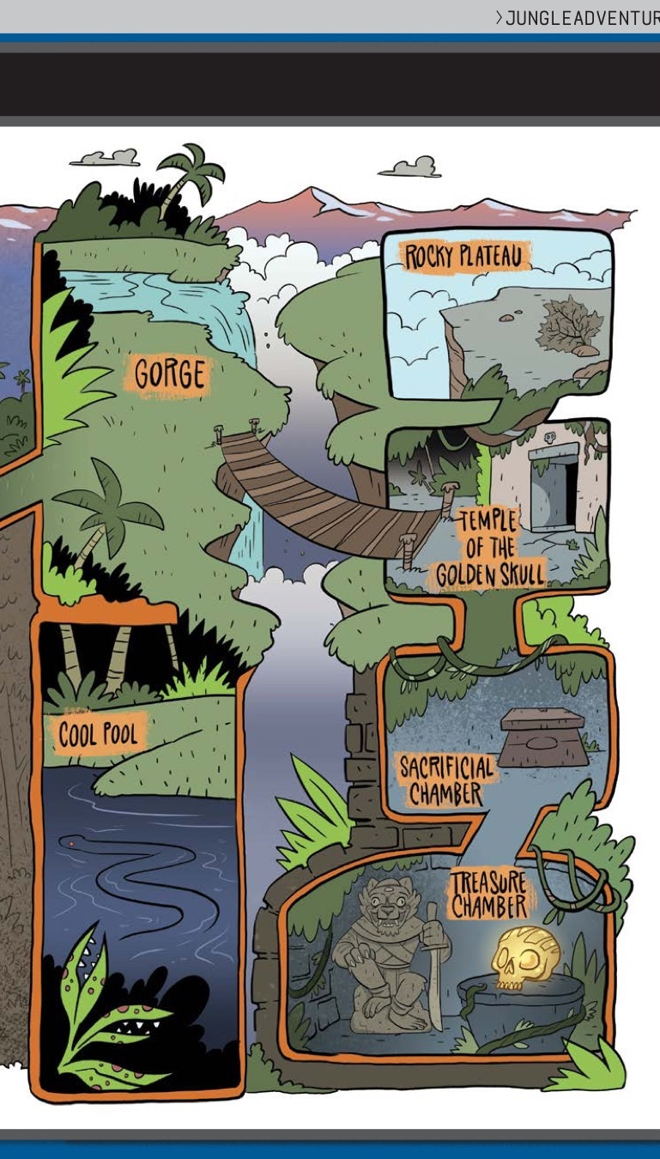
DEEP JUNGLE
You are lost in the deep jungle.
> Each location within the Deep Jungle has four exits: NORTH, SOUTH, EAST and WEST. Some of these—marked with U-turn arrows—lead back to the previously entered area.
> If the player examines the compass while lost in the Deep Jungle, the actual exits are revealed and the U-turns are ignored.
Notes:
This is the Jungle Adventure Map from Jared A Sorensen’s Parsley book.

Slide 29
Maps and Mazes
There was a maze in Adventure that was essentially impossible to get through without making a map. The pirate’s maze offered rooms that were all uniformly described as “a maze of twisty little passages, all alike.”
To figure out which room was which, the player character had to drop objects to mark the different rooms. The rooms, once all alike, could then be differentiated based on their contents, and mapping ping of the usual sort was possible.

Slide 30
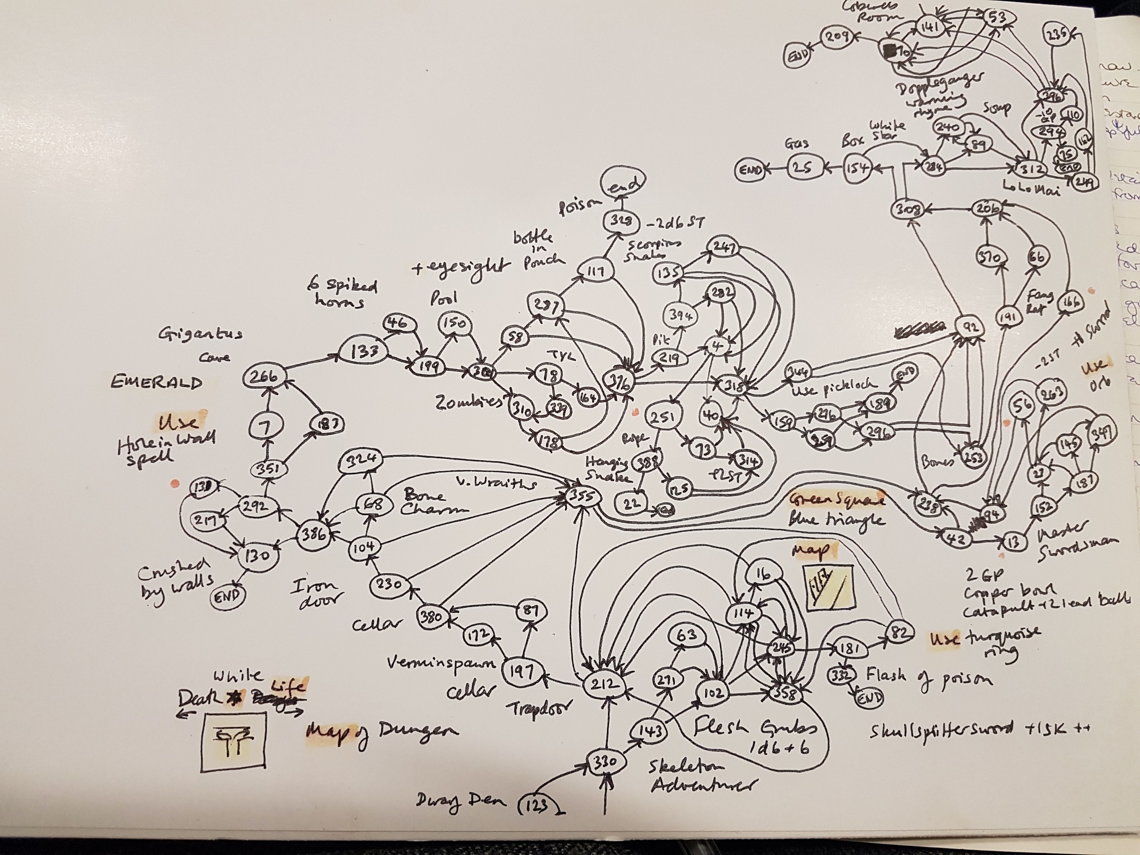
Notes:
One of Ian Livingstone’s beautiful handdrawn maps for Port of Peril
https://medium.com/hello-words/ian-livingstones-top-tips-for-interactive-fiction-df16d987542e

Slide 31
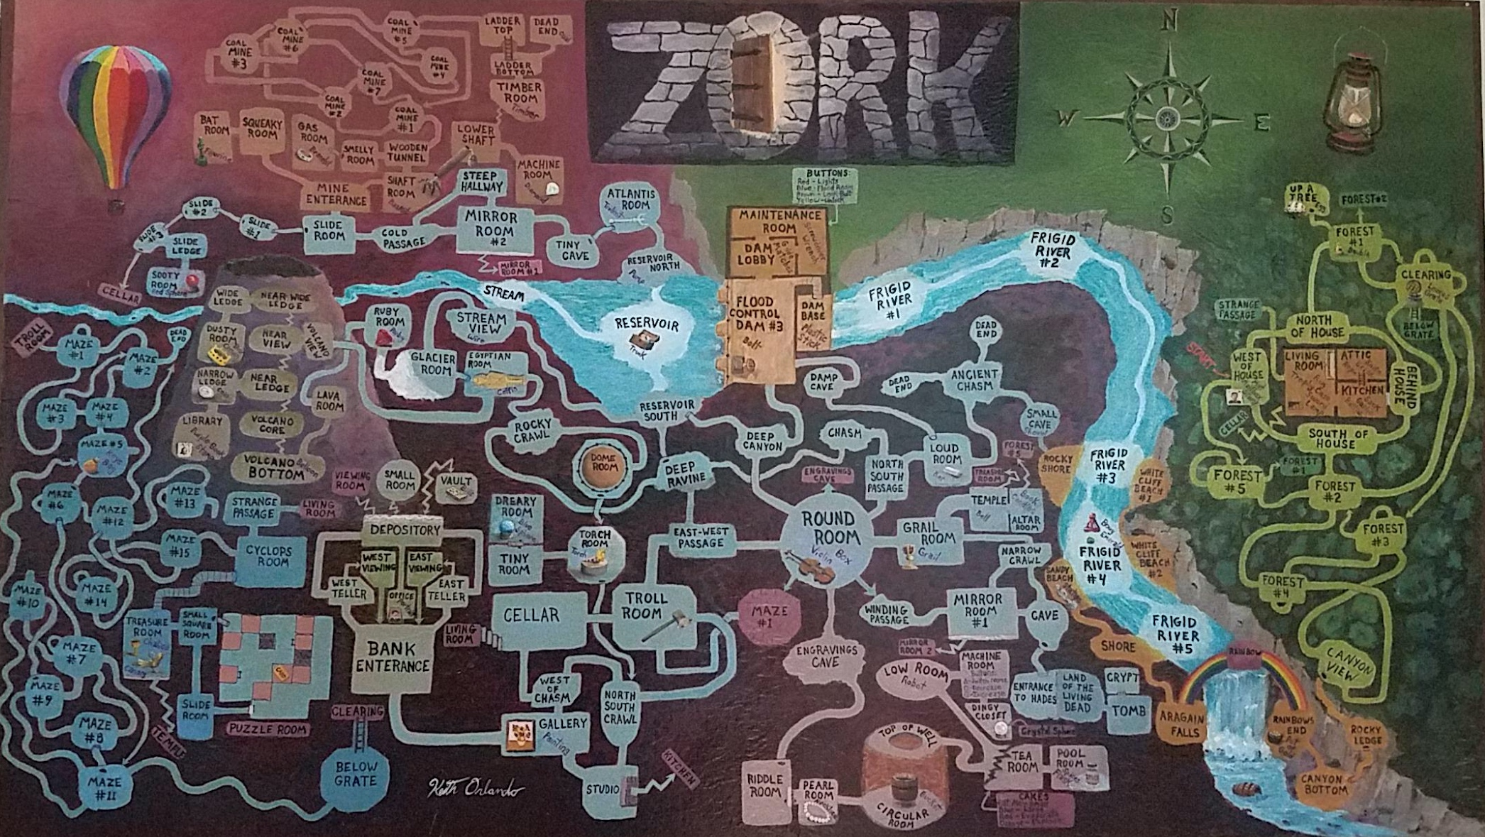
Notes:
Credit: Reddit user ion_bond Source URL: https://www.reddit.com/r/zork/comments/5ximil/zork_map_mit_version_fantastic_game_i_spent_some/

Slide 32
Objects
In Adventure, instead of a realistic simulation of caving, the author placed five treasures within as an incentive to explore the cave.
The player had to figure out how to get past a snake to move deeper into the cave. The player is attacked by dwarves and their treasure is stolen by a pirate.

Slide 33
Examine Lamp
Items represent things in the game world. Usually they are mentioned in the description of a location like:
You are on the dungeon stairs. From above, you can make out some of the king’s guards talking about current events. Someone’s left an old lamp here.
Players can inspect them with the “EXAMINE” command.
> EXAMINE LAMP This old lamp seems like it’s seen some use. It ran out of oil ages ago.

Slide 34
Get Lamp
Players can pick up objects in the world, and they are added to the player’s inventory with the “GET” command. The inventory is the set of things that the player has collected along the way.
Oftentimes, they are used to solve puzzles. For instance, you must have a lamp in your inventory in order to explore a dark cave. To list all items that you have, you can issue the “INVENTORY” command (or just the letter “I”).

Slide 35
Light lamp
Objects often have special commands associated with them. For instance, in order to solve the darkness puzzle you must say “LIGHT LAMP”.
Some special commands require more than one object in your inventory.
BREAK EGG
BREAK EGG WITH SWORD

Slide 38
Object properties
Containment: Objects may have contents (the bottle can have wine in it)
Weight: Objects have weight (some objects might be too heavy to lift)
Position: An object may be in, on, or under another object

Slide 39
People are objects too
In Zork, a handful of living opponents thwart the adventurer: the troll, who stays put in a single room and serves as an obstacle; the vampire bat, who can carry off the adventurer; the cyclops, who can dine on the adventurer; and the thief, who wanders around the underground areas stealing items from the adventurer.
These people/opponents can be implemented as objects too. People objects often have a special command for dialogue via “TALK TO”.

Slide 40
Vehicles and Robots
Zork included vehicles including a hot air balloon and a boat. They were implemented as if they were mobile rooms.
It also had a robot that the player had to command in order to get through one section of the game.

Slide 41
Commands
Players input simple sentences such as “get key” or “go east”, which are interpreted by a text parser. Parsers may vary in sophistication; the first text adventure parsers could only handle two-word sentences in the form of verb-noun pairs.
Notes:
In the case of Adventure’s “two-word” parser, which only accepts input of the form “verb” or “verb noun,” determining the grammatical structure of the input is trivial.

Slide 42
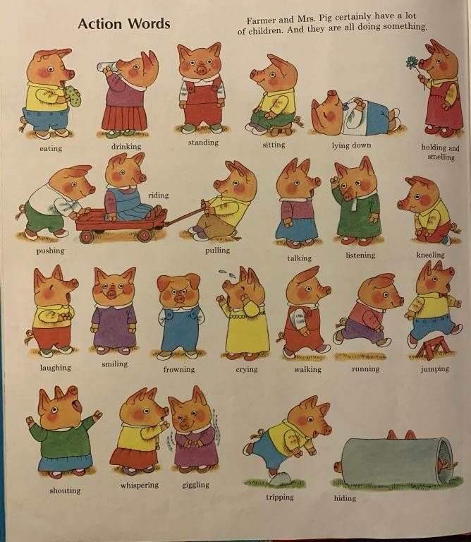
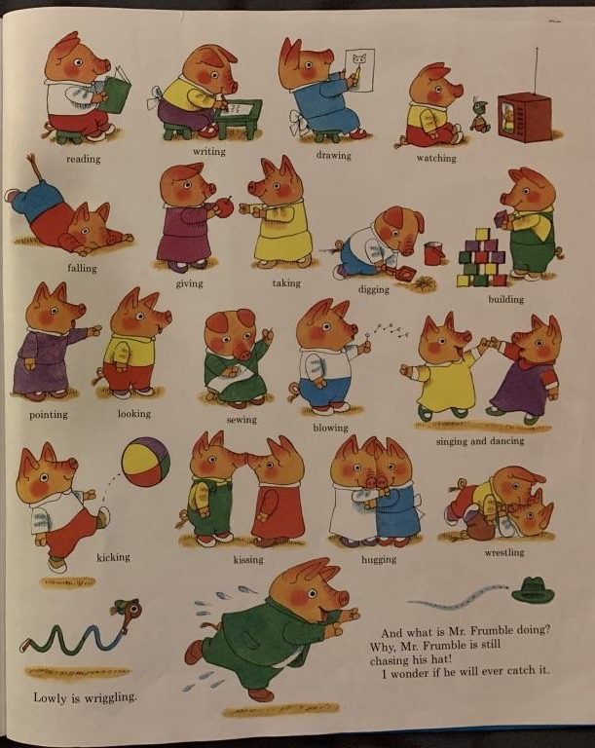
Notes:
Verbs

Slide 43
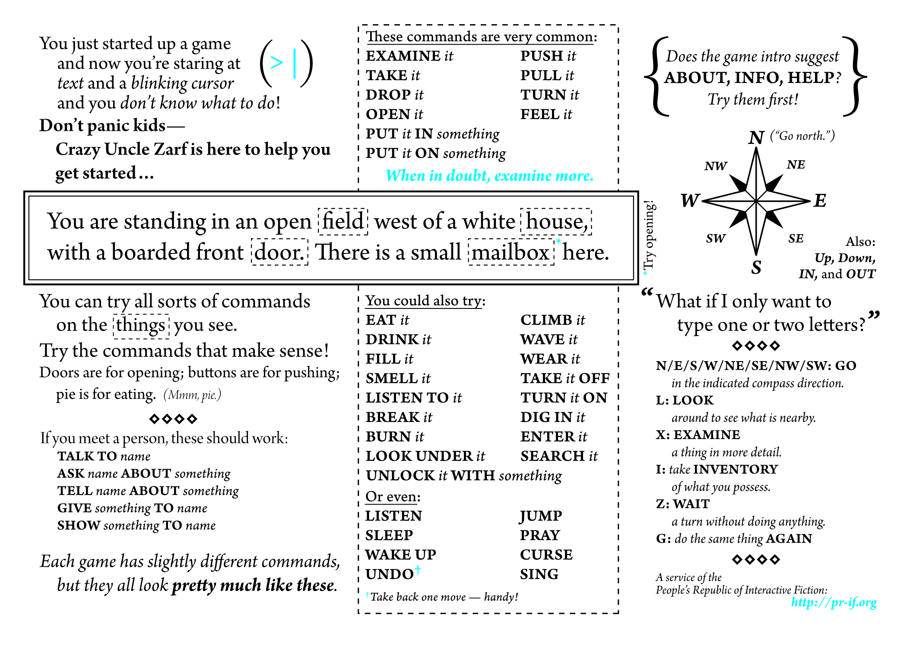

Slide 44
Notes:
Can’t handle everyone, want to handle the most common and most interesting things that people might try.

Slide 45
Early Parsers
Adventure’s verb-noun parser was extremely primitive but removed ambiguity.
Ambiguity means that there are multiple interpretations of a sentence, which denote distinct meanings.
Notes:
It only accepted verb-noun commands, so that limits the possible interpretations of sentences.
Adventure, with its primitive but effective way of understanding language, that endures and that became widespread. It also became the archetype of the text adventure and of interactive active fiction.

Slide 47
I saw the girl with the telescope.

Slide 48

I saw the girl with the telescope.

Slide 49
Vocabulary
The original Zork I (1980) had a 600-word vocabulary.
Trinity (1986) could understand stand 2,120 different words.

Slide 50
Basic Linguistics
Stop words: Function words like “the” could be stripped from user input, so that “GET THE LAMP” was sent to the parser as “GET LAMP”.
Prepositions: “LOOK AT” and “LOOK UNDER” were only considered different by the parser if they were implemented as separate verbs and mapped onto different actions.
Direct and indirect objects: Some parsers recognized direct and indirect objects like GIVE [THE BOOK] TO [DAPHNE].
Notes:
Adventure has the player's character explore a mysterious cave that is rumored to be filled with treasure and gold. To explore the cave, the player types in one- or two-word commands to move their character through the cave, interact with objects in the cave, pick up items to put into their inventory, and other actions. The program acts as a narrator, describing to the player what each location in the cave has, the results of certain actions, or if it did not understand the player's commands, asking for the player to retype their actions.

Slide 51
“open the red box with the green key then go north”.
Later parsers, such as those built on ZIL (Zork Implementation Language), could understand complete sentences. They could handle more complex inputs.

Slide 52
Z-machine
Infocom developed a virtual machine to deploy standardized “story files” on many platforms. The Infocom parser was the best of its era. It accepted complex, complete sentence commands when its competitors’ parsers were restricted to simple two-word verb-noun combinations. Its parser was actively upgraded, and later games would ‘understand’ multiple sentence input: ‘pick up the gem and put it in my bag. take the newspaper clipping out of my bag then burn it with the book of matches’.
Notes:
Infocom developed a custom virtual machine that could be implemented on a large number of platforms, and took standardized “story files” as input. Infocom was responsible for developing the interactive style that would be emulated by many later interpreters. The Infocom parser was widely regarded as the best of its era. It accepted complex, complete sentence commands like “put the blue book on the writing desk” at a time when most of its competitors parsers were restricted to simple two-word verb-noun combinations such as “put book”. The parser was actively upgraded with new features like undo and error correction, and later games would ‘understand’ multiple sentence input: ‘pick up the gem and put it in my bag. take the newspaper clipping out of my bag then burn it with the book of matches’.

Slide 53
https://www.youtube.com/watch?v=LRhbcDzbGSU&t=2361
Notes:
“You are going to type something and the computer is not going to understand it.”
https://www.youtube.com/watch?v=LRhbcDzbGSU&t=2361
4 minute clip – end at 43:25 (kill the player)
39:20 - Language understanding difficulty
41:30 - ELIZA
43:10 - potential end point (after you’ve implemented it yourself, your perspective changes)
43:25 - potential end point (we just killed the player)

Slide 54
Why were parsers so bad?
Limited computational resources. Computers had ≤128 KB of memory
Language is difficult. There are many things that make human languages genuinely challenging for a computer to process.
Keyword-based commands. Only exact matches worked properly. No synonyms, no paraphrases.
Everything was manual. Game developers had to anticipate all possible commands, and manually code the responses.
No machine learning. This was prior to the advent of machine learning based natural language processing

Slide 55
Puzzles
In most interactive fiction, puzzles (sorts of challenges or obstacles) are part of the world the player character moves through. In order to complete the IF work, the interactor must figure out how to meet these challenges.

Slide 56
https://www.youtube.com/watch?v=LRhbcDzbGSU&t=3819
Notes:
Puzzles – 2 minutes. https://www.youtube.com/watch?v=LRhbcDzbGSU&t=3819
103:50 - narrative+puzzles
End. 105:56 The actual act of winning is trivial

Slide 57
Puzzle Solutions
The solutions may be arrived at through the player character’s senses or by having the player character manipulate things in the surroundings and then observe the results to determine the workings of the world.
Most interactive fiction does not have great replay value. You cannot simply “replay” a riddle if you know its answer.
However, once you learn to play a board game, the knowledge gained from playing it once game doesn’t ruin the experience of playing it again.

Slide 58
Zork’s diamond machine
In the coal mine, the player character finds a machine with a tiny slot in the top of it. What this machine does, and how to turn it on, is unclear.
The solution is to put some coal into the machine, and then turn on the machine using the screwdriver. This results in the coal being compressed with great force producing a diamond.
The player can act as scientist and put anything inside, then observe the results.

Slide 59
Guess the Verb
A few puzzles require the player “guess the verb” and perform an action that would not be obvious from the commands available. The game's parser does not understand unless the player uses a particular way to phrase the command (sometimes non-obvious).
For example, if there is a crate to be opened with a crowbar and the only way to open it is to "pry crate with crowbar", other actions like "open crate with crowbar" give a misleading response. Usually this is a deficiency in the parser. Some games like Ad Verbum by Nick Montfort intentionally include guess-the-verb puzzles to good effect in contexts where the puzzles are explicitly about language.

Slide 60
Writing Style
Interactive fiction features two distinct modes of writing: the player input and the game output.
Player input is expected to be in simple command form (in linguistics, these are called imperative sentences).
> look in tea chest

Slide 61
“That was the first place you tried, hours and hours ago now, and there’s nothing there but that boring old book. You pick it up anyway, bored as you are.” –Graham Nelson Curses (1993)
Second-Person - The responses from the game are usually written using second-person pronouns like “you.” They also tend to be in present tense.
Notes:
This is because, unlike in most works of fiction, the main character is closely associated with the player, and the events are seen to be happening as the player plays.
Some IF works dispense with second-person narrative entirely, opting for a first-person perspective (‘I’) or even placing the player in the position of an observer, rather than a direct participant.
Second-Person – The reader is character within the story. This is done with the use of second-person pronouns like you. Stories and novels in second person are comparatively uncommon.

Slide 62
"I could not unlove him now, merely because I found that he had ceased to notice me." – Charlotte Brontë's Jane Eyre (1847)
First-person – A first-person narrative is a mode of storytelling in which a narrator relays events from their own point of view using the first-person pronouns "I" or "we”. The narrator is the protagonist, or retelling events that they witnessed.
Notes:
In Jane Eyre the title character is telling her own story.
Other examples of first person narration: fictional autobiographies, detective fiction, internal monologues,
https://en.wikipedia.org/wiki/First-person_narrative This device allows the audience to see the narrator's mind's eye view of the fictional universe, but it is limited to the narrator's experiences and awareness of the true state of affairs,
With a first person narrative it is important to consider how the story is being told, i.e., is the character writing it down, telling it out loud, thinking it to themselves? And if they are writing it down, is it something meant to be read by the public, a private diary, or a story meant for one other person? The way the first person narrator is relating the story will affect the language used, the length of sentences, the tone of voice and many other things. A story presented as a secret diary could be interpreted much differently than a public statement.^{[2]}
https://en.wikipedia.org/wiki/Narration A first-person point of view reveals the story through a participant narrator. First person creates a close relationship between the narrator and reader, by referring to the viewpoint character with first person pronouns like I (or we, if the narrator is part of a larger group).^{[12]} That is, the narrator openly acknowledges their own existence. Frequently, the first-person narrator is the protagonist, whose inner thoughts are expressed to the audience, even if not to any of the other characters. A first person narrator with limited omniscience is not able to witness or understand all facets of any situation. Thus, a narrator with this perspective will not be able to report the circumstances fully and will leave the reader with a subjective record of the plot details. Additionally, this narrator's character could be pursuing a hidden agenda or may be struggling with mental or physical challenges that further hamper their ability to tell the reader the whole, accurate truth of events. This form includes temporary first-person narration as a story within a story, wherein a narrator or character observing the telling of a story by another is reproduced in full, temporarily and without interruption shifting narration to the speaker. The first-person narrator can also be the focal character.

Slide 63
"You are not the kind of guy who would be at a place like this at this time of the morning. But here you are, and you cannot say that the terrain is entirely unfamiliar, although the details are fuzzy.” Jay McInerney's Bright Lights, Big City (1984)
Second-Person – The reader is character within the story. This is done with the use of second-person pronouns like you. Stories and novels in second person are comparatively uncommon.
Notes:
In Jane Eyre the title character is telling her own story.
https://en.wikipedia.org/wiki/First-person_narrative This device allows the audience to see the narrator's mind's eye view of the fictional universe, but it is limited to the narrator's experiences and awareness of the true state of affairs
https://en.wikipedia.org/wiki/Narration A first-person point of view reveals the story through a participant narrator. First person creates a close relationship between the narrator and reader, by referring to the viewpoint character with first person pronouns like I (or we, if the narrator is part of a larger group).^{[12]} That is, the narrator openly acknowledges their own existence. Frequently, the first-person narrator is the protagonist, whose inner thoughts are expressed to the audience, even if not to any of the other characters. A first person narrator with limited omniscience is not able to witness or understand all facets of any situation. Thus, a narrator with this perspective will not be able to report the circumstances fully and will leave the reader with a subjective record of the plot details. Additionally, this narrator's character could be pursuing a hidden agenda or may be struggling with mental or physical challenges that further hamper their ability to tell the reader the whole, accurate truth of events. This form includes temporary first-person narration as a story within a story, wherein a narrator or character observing the telling of a story by another is reproduced in full, temporarily and without interruption shifting narration to the speaker. The first-person narrator can also be the focal character.

Slide 64
"There was a table and the March Hare and the Hatter were having tea at it: a Dormouse was sitting between them, and the other two were using it as a cushion..." – Alice’s Adventures in Wonderland (1865)
Third-Person – All characters are referred to with third person pronouns like he, she, or. This makes it clear that the narrator is an uninvolved entity who conveys the story but is not a character in it.
Notes:
In Jane Eyre the title character is telling her own story.
Other examples of first person narration: fictional autobiographies, detective fiction, internal monologues,
https://en.wikipedia.org/wiki/First-person_narrative This device allows the audience to see the narrator's mind's eye view of the fictional universe, but it is limited to the narrator's experiences and awareness of the true state of affairs,
With a first person narrative it is important to consider how the story is being told, i.e., is the character writing it down, telling it out loud, thinking it to themselves? And if they are writing it down, is it something meant to be read by the public, a private diary, or a story meant for one other person? The way the first person narrator is relating the story will affect the language used, the length of sentences, the tone of voice and many other things. A story presented as a secret diary could be interpreted much differently than a public statement.^{[2]}
https://en.wikipedia.org/wiki/Narration A first-person point of view reveals the story through a participant narrator. First person creates a close relationship between the narrator and reader, by referring to the viewpoint character with first person pronouns like I (or we, if the narrator is part of a larger group).^{[12]} That is, the narrator openly acknowledges their own existence. Frequently, the first-person narrator is the protagonist, whose inner thoughts are expressed to the audience, even if not to any of the other characters. A first person narrator with limited omniscience is not able to witness or understand all facets of any situation. Thus, a narrator with this perspective will not be able to report the circumstances fully and will leave the reader with a subjective record of the plot details. Additionally, this narrator's character could be pursuing a hidden agenda or may be struggling with mental or physical challenges that further hamper their ability to tell the reader the whole, accurate truth of events. This form includes temporary first-person narration as a story within a story, wherein a narrator or character observing the telling of a story by another is reproduced in full, temporarily and without interruption shifting narration to the speaker. The first-person narrator can also be the focal character.

Slide 65
Third-Person – The narrator refers to all characters with third person pronouns like he, she, or they, and never first- or second-person pronouns. This makes it clear that the narrator is an unspecified entity or uninvolved person who conveys the story and is not a character of any kind within the story.
Notes:
Traditionally, third-person narration is the most commonly used narrative mode in literature. It does not require that the narrator's existence be explained or developed as a particular character, as would be the case with a first-person narrator. It thus allows a story to be told without detailing any information about the teller (narrator) of the story. Instead, a third-person narrator is often simply some disembodied commentary or voice, rather than a fully developed character.
https://en.wikipedia.org/wiki/Narration#Third-person

Slide 66
Stories
What kind of stories are possible in interactive fiction? Can they be high-brow literature?

Slide 67
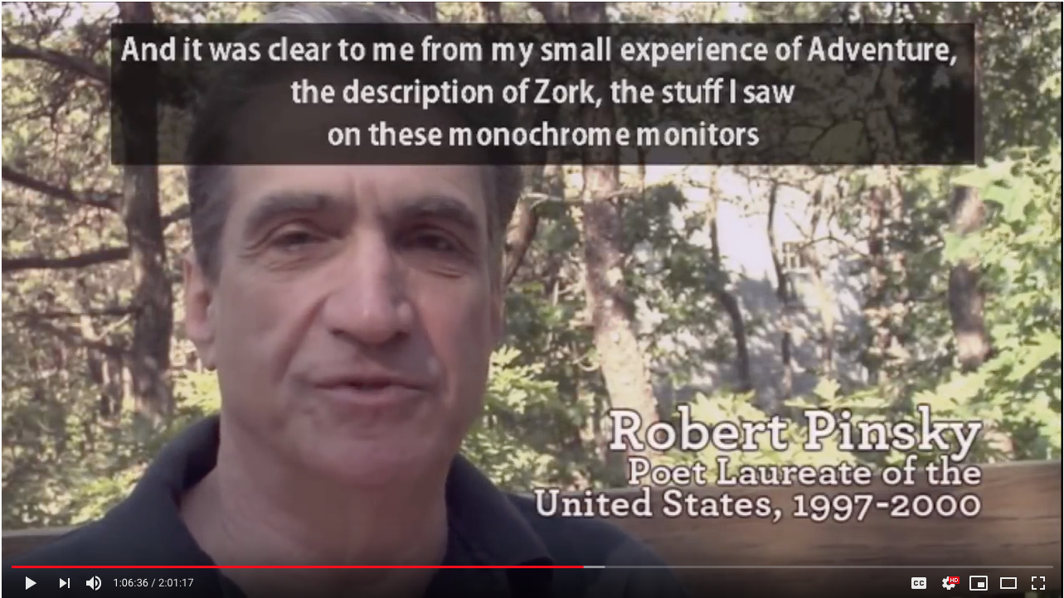
https://www.youtube.com/watch?v=LRhbcDzbGSU&t=3955
Notes:
https://www.youtube.com/watch?v=LRhbcDzbGSU&t=3955
Narratives (The quest – 1 minute)
105:55 - Robert Pinsky
107:06 - potential end - The imagery was very traditional

Slide 68
In-class Activity: Play Bronze
Play in groups of 2-3. Draw a map as you go (you can use the whiteboards). Answer the questions.

Slide 69
Artificial Intelligence
How can artificial intelligence help us design better interactive fiction?
Can text adventure games help us create better AI?

Slide 70
From: goetz@acsu.buffalo.edu (Phil Goetz)
Subject: Re: Adventure generators (skippable)
Newsgroups: rec.arts.int-fiction
Date: 29 Oct 92 04:40:05 GMT
Sender: nntp@acsu.buffalo.edu
Organization: State University of New York at Buffalo/Comp Sci
morpheus@sage.cc.purdue.edu (Morpheus Nosferatu) writes:
>Has anyone ever worked on, or even heard of, an adventure generator?
>
>I'm not talking about an adventure design language like TADS or Alan,
>but rather a stand-alone adventure generator that produces complete
>adventures, where the user need only give a minimal degree of input,
>such as the level of complexity, type of adventure (mystery, treasure
>hunt, etc.), size of adventure, and so forth?
>...
>But as anyone ever heard of someone trying to come up with a generator
>whigh would produce infocom-style text adventures? I can just imagine
>what kind of limitations it would have, but I'm curious to know if
>anyone has tried this, and if so what degree of success they've had.

Slide 71
No. ... The generator you speak of is not written, not being written,
and not anywhere on the horizon. In 50 years, maybe. In 20,
definitely not. The problem of writing interesting stories, which
adhere to someone's definition of a plot (with goal explanations,
conflict, resolution, comlication, climax, etc., all occuring at
appropriate intervals) is very hard, and I don't expect a solution
soon. But the problem of writing clever puzzles involves much greater
creativity, and I have seen NO evidence that ANYBODY has a clue in
these creativity issues; the most you will find in the field are a
few vague theories of creativity.
This problem is what Stuart Shapiro calls "AI-complete": Solving it
would be equivalent to solving all the other problems of AI.
Phil
goetz@cs.buffalo.edu

Slide 72
Text World
In 2018, Microsoft released a system that automatically generates text adventure games. These games can be played by human gamers, but they are really intended to be a testbed for automatic agents.

Slide 73
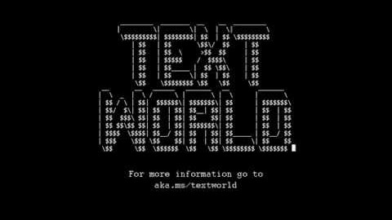
https://www.youtube.com/watch?v=WVIIigrPUJs&t=33
Notes:
3 minute clips
Text-based games are great tools for AI research because to succeed at a text-based game an AI needs to understand language, perform common-sense reasoning, deal with a combinatorial action space and overcome common reinforcement learning problems like partial observability and rewards sparsity. These skills are ultimately key skills needed for artificial general intelligence.

Slide 74
AI Dungeon
The project finetuned a large generative language model on thousands of lines of text adventure games. You will play with this later in class.

Slide 75
You are Donald, a noble living in the kingdom of Larion. You have a pouch of gold and a small dagger. You are awakened by one of your servants who tells you that your keep is under attack. You look out the window and see a large army marching towards your door. "Run!" you shout, "I'll fight them off." The next day, you wake up to find yourself alone on the battlefield. Your soldiers have been killed or turned into mindless beasts. The enemy has won!

Slide 76
You are Donald, a noble living in the kingdom of Larion. You have a pouch of gold and a small dagger. You are awakened by one of your servants who tells you that your keep is under attack. You look out the window and see a large army marching towards your door. "Run!" you shout, "I'll fight them off." The next day, you wake up to find yourself alone on the battlefield. Your soldiers have been killed or turned into mindless beasts. The enemy has won! > Run for president. You turn around and begin running towards the palace. It's time to make a change, but how?

Slide 77
You are Donald, a noble living in the kingdom of Larion. You have a pouch of gold and a small dagger. You are awakened by one of your servants who tells you that your keep is under attack. You look out the window and see a large army marching towards your door. "Run!" you shout, "I'll fight them off." The next day, you wake up to find yourself alone on the battlefield. Your soldiers have been killed or turned into mindless beasts. The enemy has won! > Run for president. You turn around and begin running towards the palace. It's time to make a change, but how? > Choose campaign slogan. "We're gonna be great again!" You raise your fist and yell as loud as you can. You hear a few cheers from the crowd. This seems to cheer you up, so you continue shouting it louder until everyone is cheering along with you.

Slide 78
Natural Language Processing

Slide 79
Lexical Knowledge Bases
NLP researchers have built structure knowledge bases and ontologies that encode a lot of important information about the meaning of words.

Slide 80
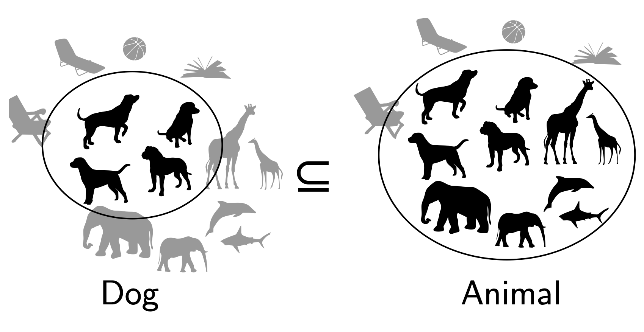
Notes:
Entailment in formal semantics

Slide 81
Entailment in formal semantics
All animals have an ulnar artery
⇒
All dogs have an ulnar artery
+ Mathematically well-understood + Powerful machinery for handling logical operations

Slide 82
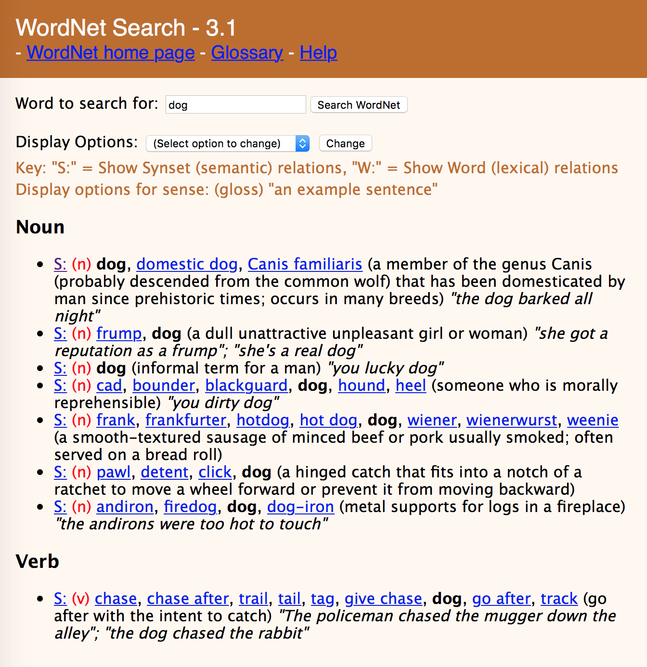

Slide 85
Word Embeddings
Vector space semantics provide a way of learning which words are similar to each other, based on what words they co-occur with.

Slide 86
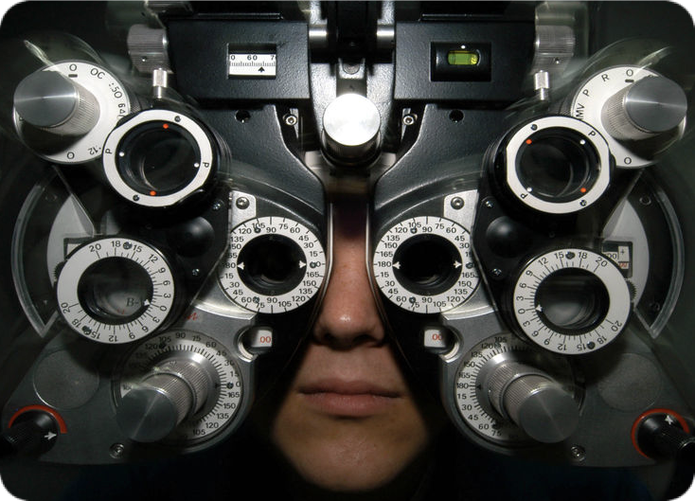
Distributional Hypothesis
If we consider optometrist and eye-doctor we find that, as our corpus of utterances grows, these two occur in almost the same environments. In contrast, there are many sentence environments in which optometrist occurs but lawyer does not...
It is a question of the relative frequency of such environments, and of what we will obtain if we ask an informant to substitute any word he wishes for oculist (not asking what words have the same meaning).
These and similar tests all measure the probability of particular environments occurring with particular elements... If A and B have almost identical environments we say that they are synonyms.
–Zellig Harris (1954)
Notes:
Similar messages expressed by Wittgenstein (1953) and Firth (1957) who said “You shall know a word by the company it keeps.”
VSMs are interesting especially due to their relation with the distributional hypothesis and related hypotheses. The distributional hypothesis is that words that occur in similar contexts tend to have similar meanings. Efforts to apply this abstract hypothesis to concrete algorithms for measuring the similarity of meaning often lead to vectors, matrices, and higher-order tensors.

Slide 87
Intuition of distributional word similarity
Nida (1975) example: A bottle of tesgüino is on the table Everybody likes tesgüino Tesgüino makes you drunk We make tesgüino out of corn.
From context, you can guess what tesgüino means.
Notes:
From context words humans can guess tesgüino means an alcoholic beverage like beer
Intuition for algorithm: Two words are similar if they have similar word contexts.

Slide 88
Term-Document Matrix
 | D1 | D2 | D3 | D4 | D5
abandon
abdicate
abhor
academic
…
zygodactyl
zymurgy
Notes:
Documents can be things like Shakespeare’s plays, or novels, or web pages

Slide 89


Term-Document Matrix
 | D1 | D2 | D3 | D4 | D5
abandon
abdicate
abhor
academic
…
zygodactyl
zymurgy
Each column vector
represents a Document
Notes:
Documents can be things like Shakespeare’s plays, or Wikipedia pages, or IMDB reviews for a movie.

Slide 90
Term-Document Matrix Matrix
 | D1 | D2 | D3 | D4 | D5
abandon
abdicate
abhor
academic
…
zygodactyl
zymurgy
Each row vector
represents a Term

Slide 91


Term-Document Matrix
 | D1 | D2 | D3 | D4 | D5
abandon
abdicate |  | 3
abhor
academic
…
zygodactyl
zymurgy
The value in a cell is
based on how often that term
occurred in that document

Slide 92

Term-Document Matrix
}
 | D1 | D2 | D3 | D4 | D5
abandon
abdicate
abhor
academic
…
zygodactyl
zymurgy
The length of the
document vectors
is the size of the vocabulary

Slide 93
Term-Document Matrix
 | D1 | D2 | D3 | D4 | D5
abandon |  | 0
abdicate |  | 3
abhor |  | 0
academic |  | 0
… |  | …
zygodactyl |  | 0
zymurgy |  | 0
Document vectors
can be sparse
(most values are 0)

Slide 94


Term-Document Matrix
 | D1 | D2 | D3 | D4 | D5
abandon
abdicate
abhor
academic
…
zygodactyl
zymurgy
We can measure
how similar two
documents are
by comparing their
column vectors

Slide 95
Co-reference Resolution
Things can be referred to in many ways, including via pronouns like she, he, it, they, them, those, that. Humans can easily figure out what they refer to. Computers can’t.

Slide 96
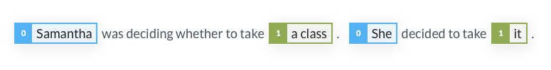


Co-reference resolution

Slide 97
Text Classifiers
Given a collection of texts that each have a label associated with them, a classifier can be trained to predict the label given the text.

Slide 98
Text Classification
Assigning subject categories, topics, or genres
SPAM detection
Authorship identification
Age/gender identification
Language Identification
Sentiment analysis
Does this sound like Shakespeare?

Slide 99
Dependency Parsing
We are often interested in syntactic questions like “What is the subject of this verb? What is the object?” Dependency parsing helps us to answer these.

Slide 100
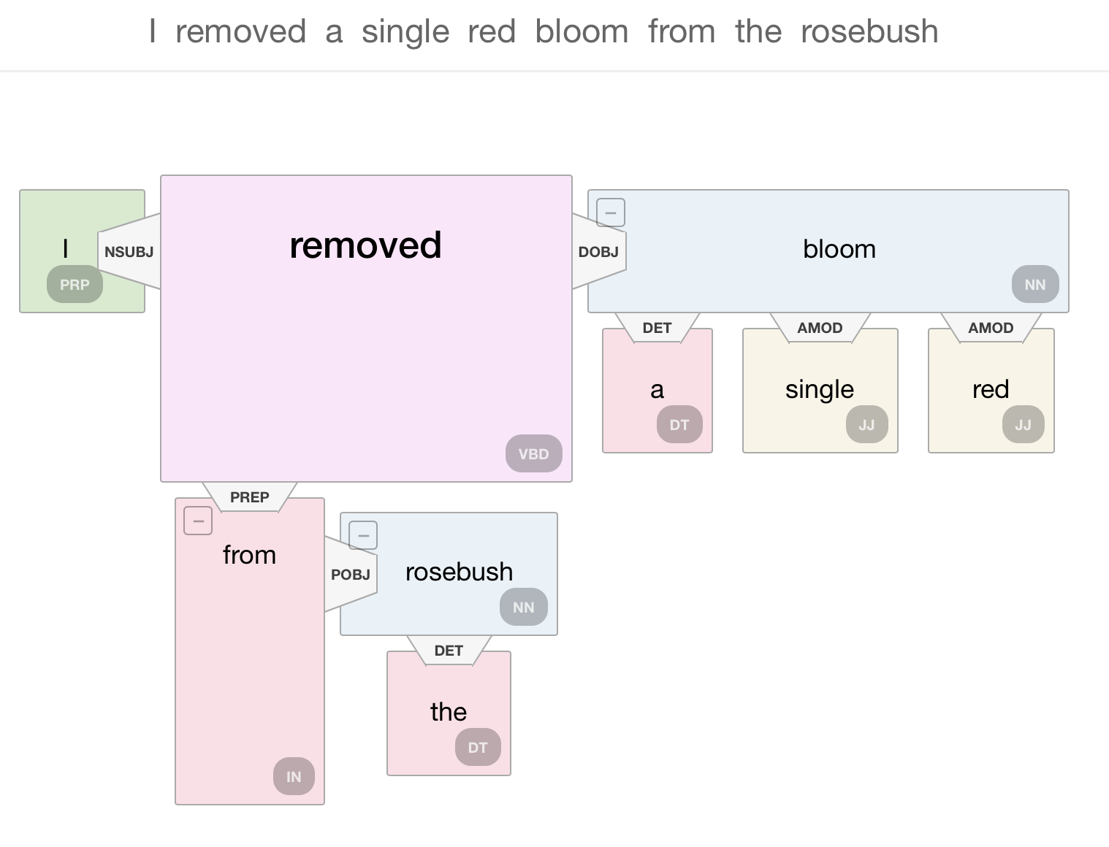

Slide 101
Language Models
Language models are text generation systems. They take an input sequence of text, and try to predict the most likely next word, or word sequence.

Slide 102

GPT-2
Open AI trained a large-scale unsupervised language model called GPT-2 which generates coherent paragraphs of text. These large-scale language models generate surprisingly coherent text. They have allowed NLP researchers to make advances to many NLP research problems like automatic question answering, machine translation, and commonsense reasoning.

Slide 103
Human written prompt: In a shocking finding, scientist discovered a herd of unicorns living in a remote, previously unexplored valley, in the Andes Mountains. Even more surprising to the researchers was the fact that the unicorns spoke perfect English.
GPT-2 completion: The scientist named the population, after their distinctive horn, Ovid’s Unicorn. These four-horned, silver-white unicorns were previously unknown to science.
Now, after almost two centuries, the mystery of what sparked this odd phenomenon is finally solved.
Dr. Jorge Pérez, an evolutionary biologist from the University of La Paz, and several companions, were exploring the Andes Mountains when they found a small valley, with no other animals or humans. Pérez noticed that the valley had what appeared to be a natural fountain, surrounded by two peaks of rock and silver snow.
Pérez and the others then ventured further into the valley. “By the time we reached the top of one peak, the water looked blue, with some crystals on top,” said Pérez.

Slide 104
In-class Activity: Play AI-Dungeon
Play in groups of 2-3. If you find weird responses, copy-and-paste them somewhere to share. Start thinking of answers to the questions we asked.

Slide 105
Course Overview

Slide 106
Topics to be covered
Building a text adventure game
Reinforcement Learning for solving text-adventure games
Common-sense reasoning for interactive fiction
World representations
Automatic extraction of narrative structure from text
Text Generation for stories and open-ended dialog
Controllable text generation

Slide 107
Topics to be covered (continued)
Human-computer interaction principles for collaborative storytelling
Bias in generative language models
Connections to computer vision, speech, and other multimodal areas
History of storytelling and artificial intelligence

Slide 108
Grading
Five homeworks worth a total of 50%
Can be completed in groups ≤ 2
One final project worth 40%
Can be completed in groups ≤ 4
Class participation worth 10%
How to contact us
Slack channel (for discussing homeworks, project, anything related broadly to the class)
Mailing list for announcements about homeworks and lectures.
Email us with specific questions (ccb@seas.upenn.edu, daphnei@sea.upenn.edu)
Daphne will have office hours after class at 4:30 PM.

Slide 109
Student Presentations
Prepare a 10-15 minute presentation on a paper from the reading list.
Your presentation should summarize the work and discuss the ways it’s applicable to either interactive fiction or automatic story generation.
Grading:
50%: Send us your slides by Monday at 3 PM the week of
50%: presentation to the class

Slide 110

Presentation Signups
https://bit.ly/36l1nAs
Fill out this form by the end of today.

Slide 111
Homework 1
Homework 2
Implement a simple text adventure game in Python.
Due 01/23/20 at before class
Improve your text adventure game using NLP!
Due 01/30/20

Slide 112
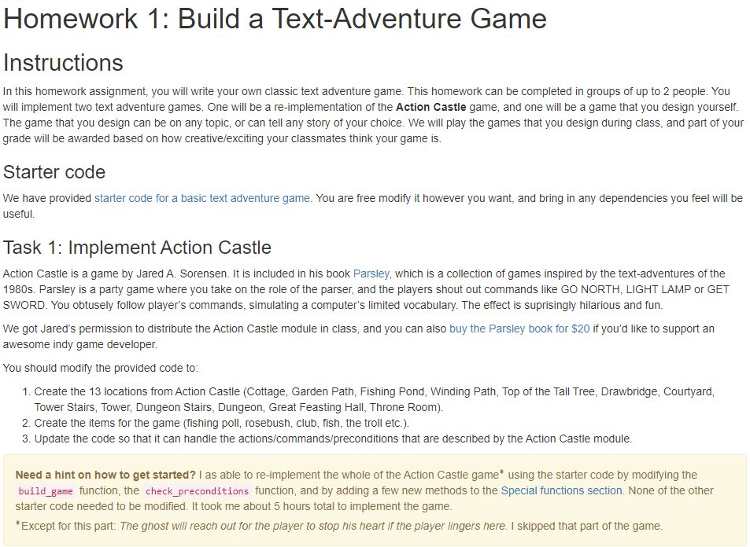
http://interactive-fiction-class.org/homeworks/text-adventure-game/text-adventure-game.html
Notes:
Tutorial on how to use colab, and how to save file to your own Github

Slide 113
In-class Activity: Play AI Dungeon
Play in groups of 2-3. Answer the questions.

